Slide 1
Phishing Website Metadata Analysis
Samantha Roberts
George Washington University
M.S. Data Science

Slide 2
Agenda
Objectives
Data Basics and Preprocessing
Analysis and Results
Associations and Correlations
Conclusion
Data Source
https://www.kaggle.com/xwolf12/malicious-and-benign-websites/home
Model Results and Predictions
Learning Processes
Exploratory Data Analysis and Pre-Model Preparations
Modeling
Data and Code Review

Slide 3
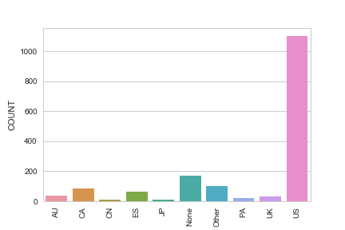
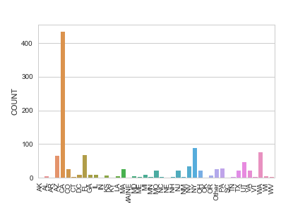
Data Preprocessing
Final Countries
Basic Data Info
1782 samples, 21 factors
42 countries
Processing Steps
10 countries/categories with 10+ samples
Final Dataset Info: US
1104 samples, 20 factors
Top 3 States:
CA (434)
NY (88)
WA (75)
US States

Slide 4
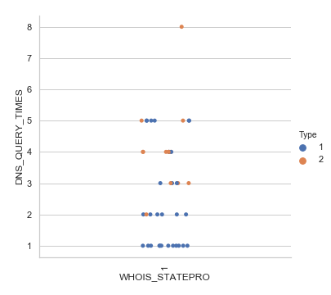
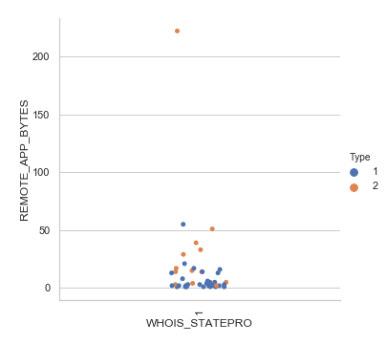
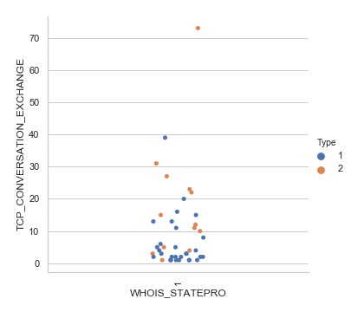
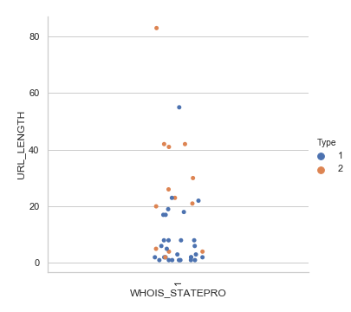
EDA
Catplots
By State
Stratified by Type
Type 1: 1 type is present in the datapoint represented (unsure benign or malicious)
Type 2: both benign and malicious
Classification eligibility

Slide 5
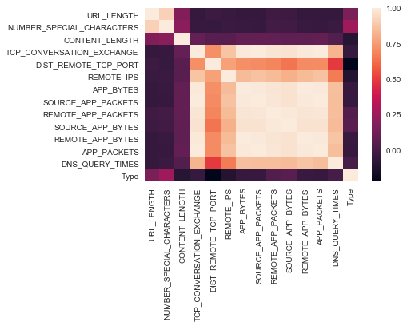
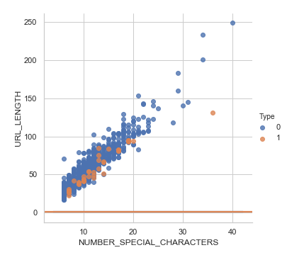
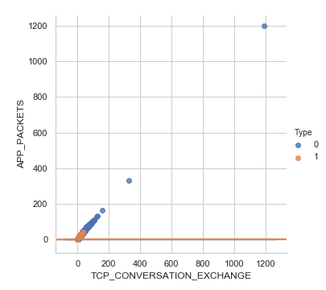
Summary Analysis
Associations and Correlations
Correlation
Type:
DIST_REMOTE_TCP_PORT: -0.14
COUNT: -0.12
NUMBER_SPECIAL_CHARACTERS: 0.11
DNS_QUERY_TIMES: 0.10
Linear
Pairplot, LMPlot
TCP_CONVERSATION_EXCHANGE
NUMBER_SPECIAL_CHARACTERS

Slide 6
Results
Random Forest Classifier
Features | Feature_Importance_
URL_LENGTH | 0.31160134
NUMBER_SPECIAL_CHARACTERS | 0.14047087
TCP_CONVERSATION_EXCHANGE | 0.04185055
DIST_REMOTE_TCP_PORT | 0.06616709
REMOTE_IPS | 0.04131351
APP_BYTES | 0.05857805
SOURCE_APP_PACKETS | 0.04625298
REMOTE_APP_PACKETS | 0.0579331
SOURCE_APP_BYTES | 0.08154459
REMOTE_APP_BYTES | 0.07136691
APP_PACKETS | 0.04824465
DNS_QUERY_TIMES | 0.02422867
Type | 0.01044768
Random Forest Classifier:
Classification model
Feature Importance
Logistic Regression:
Linear model
Accuracy Score: 0.22
Logistic Regression
Accuracy Score: 0.24

Slide 7
Conclusion
Learning Process
Future Research
Trend analysis on other host and network metadata
Domain Knowledge
Data Granularity
Socioeconomic, political, cultural factors
There is a distinct visual relationship between various variables and Type, but Type does not assist the geographical classification.
With model refinement and proper feature selection, this dataset might work well with the models selected.
Code Review

